Slide 1


Exploring Data Types, Analysis
Tools, and Learning in
Health Analytics
The Importance of Data in the Health Sector
Data plays a central role in healthcare and the improvements in the healthcare sector. Data provides the basis for informed decision-making and optimizing health outcomes.
Optimal Patient Care
Health Administrative Management
Research and Development
Management Accounting - Cost Management
Research and Development

Slide 2

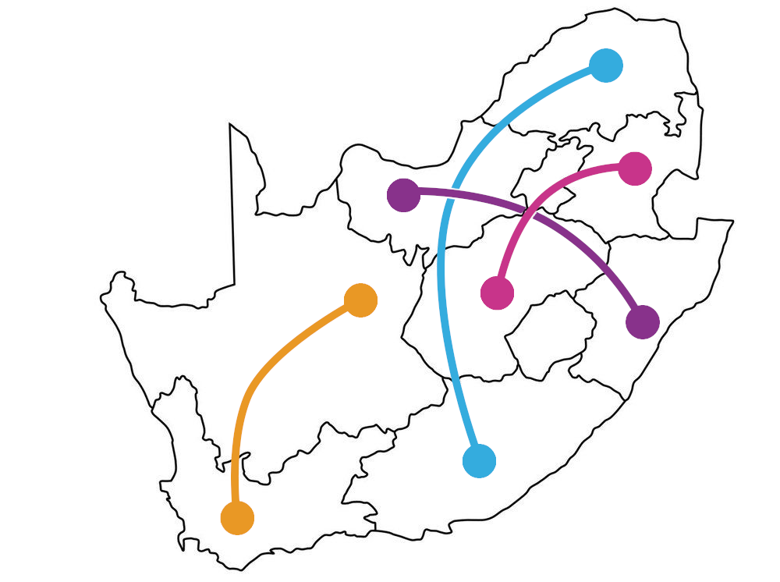
Data Sources in the
South African Health Sector
In South Africa, the healthcare sector has several key data sources play an important role in shaping various key decisions, policies and practices.
Primary Data Sources in Healthcare Sector:
National Policy Data Observatory
Stats SA
Electronic Health Records
Various Research Institutions
SACMC Epidemic Explorer
These data sources are essential in providing a multidimensional perspective on South Africa's healthcare ecosystem, which promote evidence-based key decision-making.

Slide 3
Relevant Tools and Frameworks
Various tools and frameworks are used to address challenges faced
Frameworks:
Big Data
Machine Learning Libraries
Health Informatics Platform - DHIS2
⚒️
These tools and frameworks are as facilitators in incorporating the power of data to drive impactful change..
Tools:
Open Data Kit (ODK)
GNU Health
Healthsites.io

Slide 4


Deep Dive and Case Study
District Health Information Software 2 (DHIS2) is an open-source health management information system.The platform helps the national department of health to monitor and evaluate health programs, track outbreaks, and ensure efficient use of resources.
Benefits
One of DHIS2's key strengths is its adaptability
The platform facilitates real-time data entry and reporting, allowing for timely interventions and decisions.
Through mobile applications, data can be collected and accessed even in remote areas, improving the reach and comprehensiveness of health programs.
DHIS2 has played a pivotal role in enhancing the country's health data management capabilities, providing an integrated, efficient, and effective solution to healthcare challenges from infectious diseases like HIV to logistical issues in resource allocation.

